Slide 1


OSS101

Slide 2

WHY DO OPEN SOURCE?

Slide 3

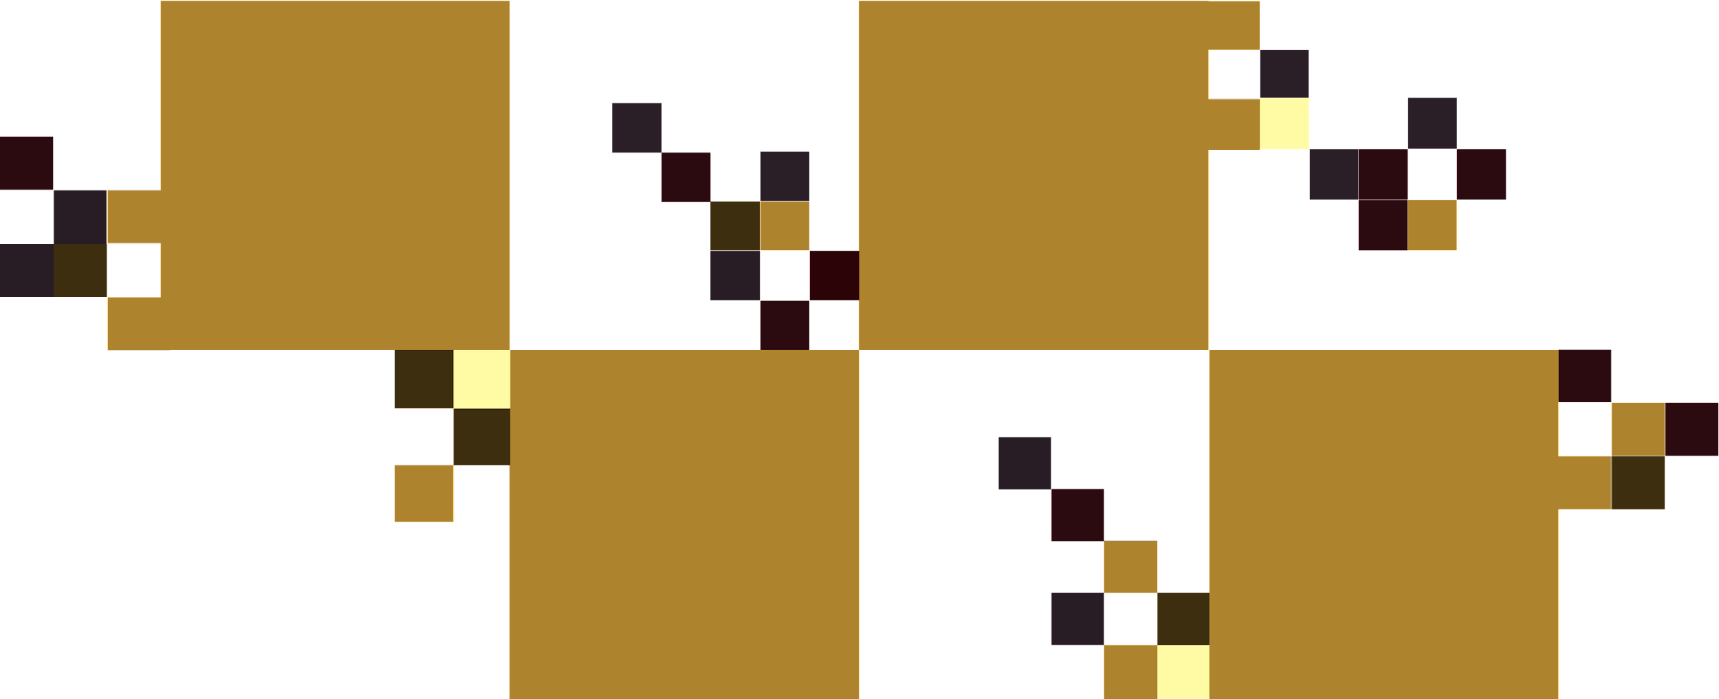
OPEN SOURCE CHALLENGE
LEARN, COLLABORATE, IMPACT GLOBALLY
SKILL ENHANCEMENT
PROFESSIONAL NETWORKING
COMMUNITY
AND COLLABORATION
PERSONAL AND PROFESSIONAL GROWTH

Slide 4

HOW TO PARTICIPATE?

Slide 5



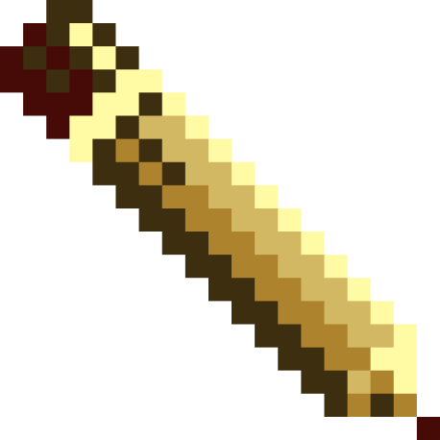
OPEN SOURCE CHALLENGE
UNDERSTAND THE REPOSITORY
OSS101
This repository is designed to help enthusiasts of all levels—beginner, intermediate, and advanced—navigate the vast landscape of open source contributions.
ADVANCED
INTERMEDIATE
BEGINNER

Slide 6







OPEN SOURCE CHALLENGE
Before diving into open source, it's essential to understand the fundamentals.
If you're new to open source, start your journey here. This section covers the basics, providing step-by-step guidance to help you make your first contributions.
Challenges mentioned in this sub directory will help you score +1
BEGINNER

Slide 7
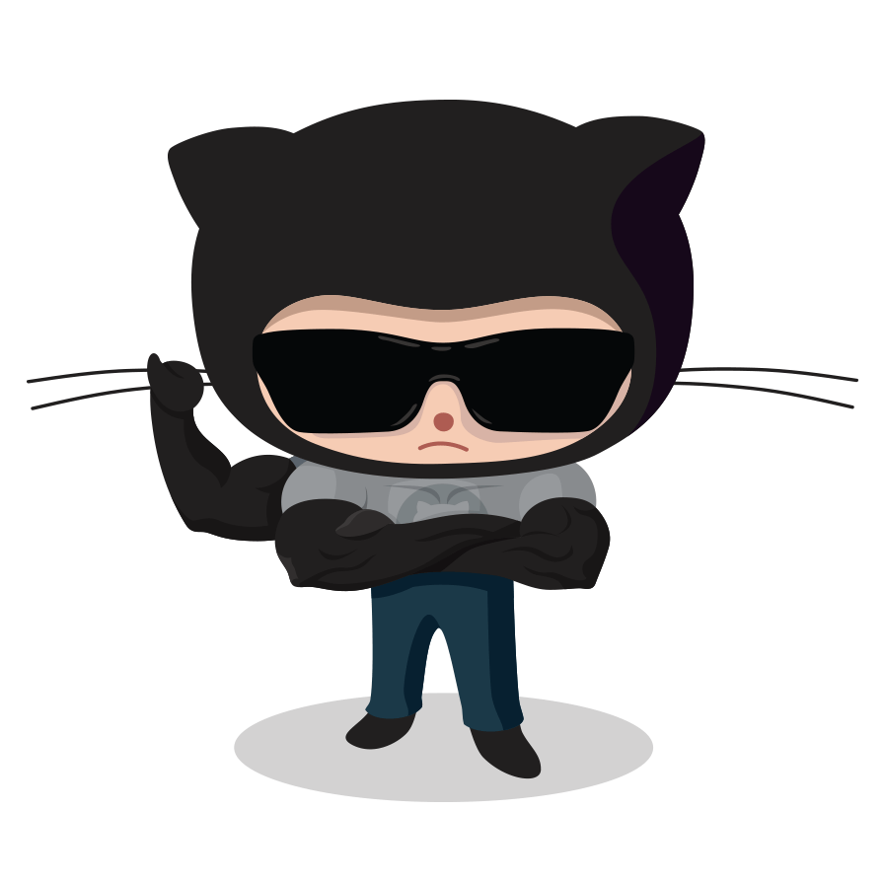
OPEN SOURCE CHALLENGE
If you're an intermediate contributor looking to make meaningful contributions, you're in the right place. Dive into intermediate topics that explore more advanced contribution strategies, project maintenance, and scaling impact within the open source community.
Challenges mentioned in this sub directory will help you score +3
INTERMEDIATE

Slide 8


OPEN SOURCE CHALLENGE
Tailored for advanced contributors who are passionate about open source and want to make a meaningful impact. Whether you're an experienced developer or a seasoned open source contributor , you are at the right place.
Challenges mentioned in this sub directory will help you score +5
ADVANCED

Slide 9


OPEN SOURCE CHALLENGE
PRIZES
DIGITAL CERTIFICATES
Unlocking the digital realm's VIP access, certificates are your golden key to code mastery – wear them proudly in the digital hall of fame!
The fun part is here!
HOLOPIN BADGES
Dive into the holographic fun with Holopin badges – wear your achievements in a shimmering dimension of recognition!
GITHUB SWAG
Dress your code in GitHub swag; wear your commits with pride – programming, but make it fashion!

Slide 10

THANKS FOR LISTENING
Contact the Open Source Challenge team for further queries: https://chat.whatsapp.com/DC6SdCbaRFeD0jbC0sTsM4

